Slide 1
Creating a table
Make sure the correct database is in use by typing the following:
USE publications;
Type this command:
CREATE TABLE classics (
author VARCHAR(128),
title VARCHAR(128),
type VARCHAR(16),
year CHAR(4) )
ENGINE MyISAM;

Slide 2
Creating a table
You could also issue this command on a single line, like this:
CREATE TABLE classics (author VARCHAR(128), title VARCHAR(128), type VARCHAR(16), year CHAR(4)) ENGINE InnoDB;
But MySQL commands can be long and complicated, so I recommend a single line at a time until you are comfortable with longer ones.
Notes:
InnoDB is the new standard (MySQL 5.5+), replacing MyISAM

Slide 3
Creating a table
MySQL should then issue the response:
Query OK, 0 rows affected (0.01 sec)
If you see an error message instead, check your syntax carefully. Every parenthesis and comma counts, and typing errors are easy to make.
In case you are wondering, the ENGINE InnoDB tells MySQL the type of database engine to use for this table.
Notes:
Other examples:
ARIA
MERGE
MEMORY (HEAP)
ARCHIVE
CSV
FEDERATED
Etc…

Slide 4
Creating a table
To check whether your new table has been created, type the following:
DESCRIBE classics;

Slide 5
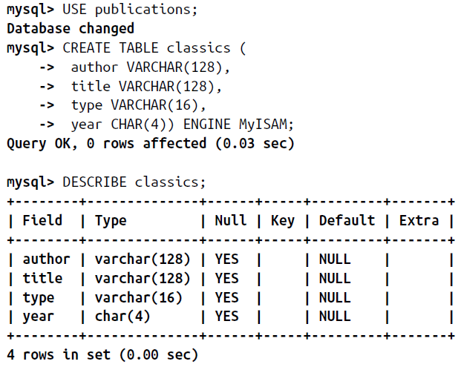
Notes:
All being well, you will see the sequence of commands and responses shown in the next slide, where you should particularly note the table format displayed.

Slide 6
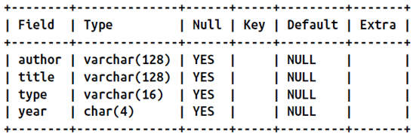
Field The name of each field or column within a table.
Type The type of data being stored in the field.
Null Whether a field is allowed to contain a value of NULL.

Slide 7
Key MySQL supports keys or indexes, which are quick ways to
look up and search for data.
The Key heading shows what type of key (if any) has been applied.
Default The default value that will be assigned to the field if no
value is specified when a new row is created.

Slide 8
Extra Additional information, such as whether a field is set to
auto-increment.

Slide 9
Data Types
CHAR
VARCHAR
TEXT
INT
FLOAT
BINARY/BYTE
VARBINARY
BLOB
DATETIME
TIMESTAMP
YEAR

Slide 10
The term VARCHAR stands for VARiable length CHARacter string, and the command takes a numeric value that tells MySQL the maximum length allowed for a string stored in this field.
This data type is very useful, as MySQL can then plan the size of databases and perform lookups and searches more easily.

Slide 11
The downside is that if you ever attempt to assign a string value longer than the length allowed, it will be truncated to the maximum length declared in the table definition.
The year field, however, has more-predictable values, so instead of VARCHAR we use the more efficient CHAR(4) data type.
The parameter of 4 allows for 4 bytes of data, supporting all years from
–999 to 9999

Slide 12
I didn’t use the YEAR data type in the classics table because it supports only the year 0000, and years 1901 through 2155.
This is because MySQL stores the year in a single byte for reasons of efficiency, but it also means that only 256 years are available, and the publication years of the titles in the classics table are well before this.

Slide 13
CHAR vs VARCHAR
The difference is that every string in a CHAR field has the specified size.
If you put in a smaller string, it is padded with spaces
A VARCHAR field does not pad the text; it lets the size of the field vary to fit the text that is inserted.
But VARCHAR requires a small amount of overhead to keep track of the size of each value.
The overhead causes access to VARCHAR data to be slightly slower than to CHAR data
Notes:
So CHAR is slightly more efficient if the sizes are similar in all records, whereas VARCHAR is more efficient if sizes can vary a lot and get large.

Slide 14
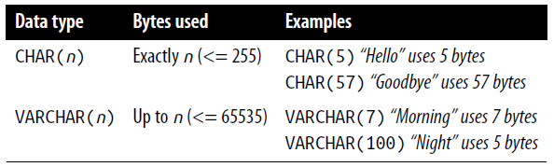
The CHAR data type
The table lists the CHAR data types.
All these types offer a parameter that sets the maximum (or exact) length of the string allowed in the field. As the table shows, each type has a built-in maximum number of bytes it can occupy.

Slide 15
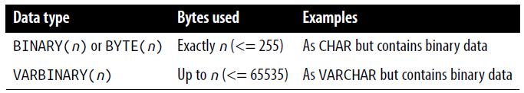
The BINARY data type
The BINARY/BYTE data type is used for storing strings of full bytes that do not have an associated character set.
For example, you might use the BINARY data type to store a GIF image

Slide 16
The TEXT and VARCHAR data types
The differences between TEXT and VARCHAR are small:
Prior to version 5.0.3, MySQL would remove leading and trailing spaces from VARCHAR fields.
TEXT fields cannot have default values.
MySQL indexes only the first n characters of a TEXT column (you specify n when you create the index).

Slide 17
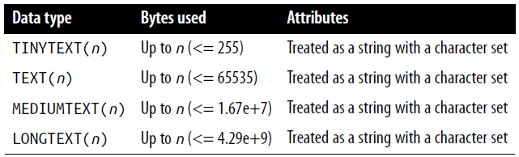
The TEXT and VARCHAR data types
What this means is that VARCHAR is the better and faster data type to use if you need to search the entire contents of a field
But, if you will never search more than a certain number of leading characters in a field, you should use a TEXT data type

Slide 18
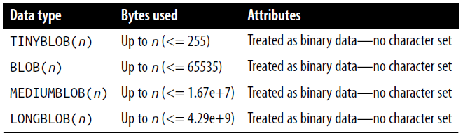
The BLOB data type
The term BLOB stands for Binary Large OBject and, therefore, as you would think, the BLOB data type is most useful for binary data in excess of 65,536 bytes in size
The main other difference between the BLOB and BINARY data types is that BLOBs cannot have default values

Slide 19
Numeric data types
MySQL supports various numeric data types from a single byte up to double-precision floating-point numbers.
Although the most memory that a numeric field can use up is 8 bytes, you are well advised to choose the smallest data type that will adequately handle the largest value you expect.
Your databases will be small and quickly accessible.

Slide 20
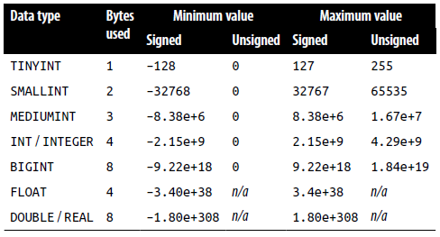
Numeric data types
This table lists the numeric data types supported by MySQL and the ranges of values they can contain.

Slide 21
Numeric data types
In case you are not acquainted with the terms, a signed number is one with a possible range from a minus value, through 0, to a positive one; and an unsigned one has a value ranging from 0 to a positive one.
They can both hold the same number of values; just picture a signed number as being shifted halfway to the left so that half its values are negative and half are positive.
Note that floating-point values (of any precision) may only be signed.

Slide 22
Numeric data types
To specify whether a data type is signed or unsigned, use the UNSIGNED qualifier
The following example creates a table called tablename with a field in it called fieldname of the data type UNSIGNED INTEGER:
CREATE TABLE tablename (fieldname INT UNSIGNED);

Slide 23
Numeric data types
When creating a numeric field, you can also pass an optional number as a parameter, like this:
CREATE TABLE tablename (fieldname INT(4));
NOTE: this parameter does not indicate the number of bytes of storage to use.
It may seem counterintuitive, but what the number actually represents is the display width of the data in the field when it is retrieved.

Slide 24
Numeric data types
It is commonly used with the ZEROFILL qualifier, like this:
CREATE TABLE tablename (fieldname INT(4) ZEROFILL);
What this does is cause any numbers with a width of less than four characters to be padded with one or more zeros, sufficient to make the display width of the field four characters long.
When a field is already of the specified width or greater, no padding takes place.

Slide 25
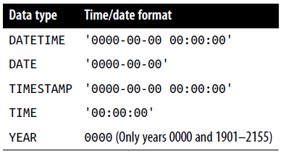
DATE and TIME
The main remaining data types supported by MySQL relate to the date and time and can be seen here:

Slide 26
DATE and TIME
The DATETIME and TIMESTAMP data types display the same way.
The main difference is that TIMESTAMP has a very narrow range (from the years 1970 through 2037)
Whereas DATETIME will hold just about any date you’re likely to specify, unless you’re interested in ancient history or science fiction.
TIMESTAMP is useful, however, because you can let MySQL set the value for you.
If you don’t specify the value when adding a row, the current time is automatically inserted.
You can also have MySQL update a TIMESTAMP column each time you change a row.

Slide 27
The AUTO_INCREMENT data type
Sometimes you need to ensure that every row in your database is guaranteed to be unique.
You could do this in your program by carefully checking the data you enter and making sure that there is at least one value that differs in any two rows, but this approach is error-prone and works only in certain circumstances.
In the classics table, for instance, an author may appear multiple times.
Likewise, the year of publication will also be frequently duplicated, and so on.
It would be hard to guarantee that you have no duplicate rows.

Slide 28
The AUTO_INCREMENT data type
The general solution is to use an extra column just for this purpose.
In a while, we’ll look at using a publication’s ISBN (International Standard Book Number), but first I’d like to introduce the AUTO_INCREMENT data type.
As its name implies, a column given this data type will set the value of its contents to that of the column entry in the previously inserted row, plus 1.

Slide 29
The AUTO_INCREMENT data type
Adding the auto-incrementing column id
ALTER TABLE classics ADD id INT UNSIGNED NOT NULL AUTO_INCREMENT KEY;
This is your introduction to the ALTER command, which is very similar to CREATE
ALTER operates on an existing table, and can add, change, or delete columns

Slide 30
The AUTO_INCREMENT data type
INT UNSIGNED
Makes the column take an integer large enough for you to store more than 4 billion records in the table.
NOT NULL
Ensures that every column has a value. Many programmers use NULL in a field to indicate that it doesn’t have any value.
But that would allow duplicates, which would violate the whole reason for this column’s existence. So we disallow NULL values.
Notes:
Our example adds a column named id with the following characteristics

Slide 31
The AUTO_INCREMENT data type
AUTO_INCREMENT
Causes MySQL to set a unique value for this column in every row, as described earlier.
We don’t really have control over the value that this column will take in each row, but we don’t care: all we care about is that we are guaranteed a unique value.
KEY
An auto-increment column is useful as a key, because you will tend to search for rows based on this column.
Each entry in the column id will now have a unique number, with the first starting at 1 and the others counting upward from there.
And whenever a new row is inserted, its id column will automatically be given the next number in sequence.
Notes:
We’ll see more about keys later

Slide 32
The AUTO_INCREMENT data type
Rather than applying the column retroactively, you could have included it by issuing the CREATE command in a slightly different format.
Adding the auto-incrementing id column at table creation
CREATE TABLE classics (
author VARCHAR(128),
title VARCHAR(128),
type VARCHAR(16),
year CHAR(4),
id INT UNSIGNED NOT NULL AUTO_INCREMENT KEY)
ENGINE MyISAM;

Slide 33
The AUTO_INCREMENT data type
If you wish to check whether the column has been added, use the following command to view the table’s columns and data types:
DESCRIBE classics;
Removing the id column
ALTER TABLE classics DROP id;

Slide 34
Adding data to a table
To add data to a table, use the INSERT command.
INSERT INTO classics(author, title, type, year)
VALUES('Mark Twain','The Adventures of Tom Sawyer','Fiction','1876’);
INSERT INTO classics(author, title, type, year)
VALUES('Jane Austen','Pride and Prejudice','Fiction','1811’);
INSERT INTO classics(author, title, type, year)
VALUES('Charles Darwin','The Origin of Species','Non-Fiction','1856’);
INSERT INTO classics(author, title, type, year)
VALUES('Charles Dickens','The Old Curiosity Shop','Fiction','1841’);
INSERT INTO classics(author, title, type, year)
VALUES('William Shakespeare','Romeo and Juliet','Play','1594');

Slide 35
Adding data to a table
The first part, INSERT INTO classics, tells MySQL where to insert the following data.
Then, within parentheses, the four column names are listed—author, title, type, and year—all separated by commas.
This tells MySQL that these are the fields into which the data is to be inserted.

Slide 36
Adding data to a table
The second line of each INSERT command contains the keyword VALUES followed by four strings within parentheses, and separated by commas.
This supplies MySQL with the four values to be inserted into the four columns previously specified.
Each item of data will be inserted into the corresponding column, in a one-to-one correspondence.
If you accidentally listed the columns in a different order from the data, the data would go into the wrong columns. And the number of columns must match the number of data items.

Slide 37
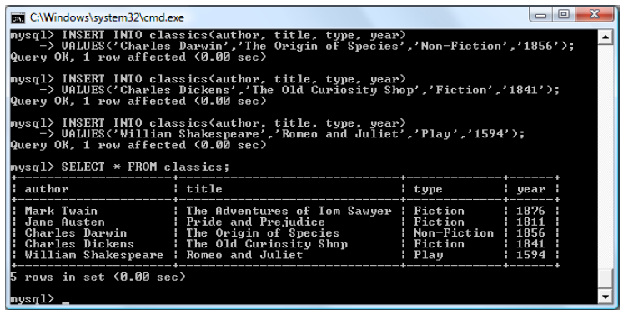
After every second line, you should see a Query OK message.
Once all lines have been entered, type the following command, which will display the table’s contents. Try this:
SELECT * FROM classics;

